Slide 1
Lesson 2: Literary Devices & Figures of Speech

Slide 2
Literary Devices – How Authors Shape Meaning
Identify and define literary devices and figures of speech
Analyze how these devices impact tone, mood, and meaning in a text
- metaphor, simile, hyperbole, tone, personification

Slide 3
Why Learn Literary Devices?
Authors use specific tools to influence how readers feel, think, and interpret meaning. If you can recognize those tools, you become a better reader, writer, and communicator.
What’s a book, movie, or quote that stuck with you? Why? Was it the message—or how it was said?
Oxymoron

Slide 4
Core Literary Devices
Device | Definition | Example
Simile | A comparison using “like” or “as” | Her voice was as smooth as velvet.
Metaphor | A direct comparison between two unrelated things | His heart was a locked door.
Personification | Giving human traits to non-human things | The thunder growled angrily in the distance.
Allusion | A brief reference to a famous person, place, event, or text | He met his Waterloo in the final round of the competition.
Symbolism | An object, person, or event that represents a deeper meaning | The dove is a symbol of peace.
Imagery | Language that appeals to the five senses | The sweet scent of rain on dry earth filled the air.
Foreshadowing | A hint or clue about what will happen later in the story | She didn’t know it then, but that decision would change everything.
Irony | A contrast between expectation and reality | A fire station burning down.
Flashback | An interruption in the story to show an earlier event | She remembered the day they first met.
Motif | A repeated image, idea, or symbol that helps develop a theme | The repeated image of falling leaves throughout a novel.
Tone | The author’s attitude toward the subject | Playful, serious, sarcastic, hopeful, etc.
Mood | The feeling or atmosphere created for the reader | Dark, tense, joyful, eerie, etc.

Slide 5
Identify the Literary Device for each sentence.
“The leaves danced in the wind.”-->personification
“She flashed back to the moment her brother left for war.” → flashback
“He was a wolf among sheep.” → metaphor
“The classroom smelled of pencil shavings and old paper.” → Imagery → appeals to the sense of smell
“A red rose appeared in every chapter.” → motif (recurring image or symbol → builds theme)

Slide 6
Figures of Speech
Euphemism →“He passed away” instead of “He died.”
Hyperbole – Extreme exaggeration “I’ve told you a million times!”
Oxymoron – Two contradictory words paired together “Deafening silence”
Paradox – A statement that seems self-contradictory but has deeper truth “Less is more.”

Slide 7
Identify the Device
“She’s between jobs right now, just taking some time off.” A. Euphemism B. Hyperbole C. Paradox D. Oxymoron
intention

Slide 8
“That math problem took forever to solve!” A. Hyperbole B. Euphemism C. Oxymoron D. Paradox

Slide 9
“The comedian delivered a seriously funny joke.” A. Hyperbole B. Oxymoron C. Euphemism D. Paradox

Slide 10
“To bring peace, we must prepare for war.” A. Hyperbole B. Euphemism C. Paradox D. Oxymoron

Slide 11
Figure of Speech | Definition | Example Sentence | Explanation
Euphemism | A polite or mild way to say something unpleasant | “She’s between jobs right now, just taking some time off.” | Softens the reality of being unemployed
Hyperbole | Extreme exaggeration for effect | “That math problem took forever to solve!” | “Forever” exaggerates the time to show frustration or intensity
Oxymoron | Two opposite words placed together | “The comedian delivered a seriously funny joke.” | “Seriously funny” combines contradictory terms to emphasize humor
Paradox | A statement that seems to contradict itself but reveals truth | “To bring peace, we must prepare for war.” | Appears illogical, but expresses a strategic reality

Slide 12
Read the quote. Identify the device used. Then answer the analysis question.
“He crossed to the other side” (used in a eulogy). Device: _Euphemism__________
Q: Why might someone choose this phrase instead of “He died”?

Slide 13
“I’m so hungry I could eat a horse.” Device: _Hyperbole __________ Q: What does this suggest about the speaker’s mood or situation?

Slide 14
“Bittersweet memories flooded back.” Device: _Oxymoron__________ Q: What effect does this contrast create?
Nuance in speech/writing (subtleness)

Slide 15
“The more you know, the more you realize you don’t know.” Device: _Paradox__________
Q: What is the deeper truth hidden in this contradiction?

Slide 16
Understanding Tone
What is Tone?(sarcastic, excited, serious, despair, urgent)
Tone is the author’s attitude toward the subject, character, or audience. It’s how the writing “sounds” — serious, playful, angry, hopeful, etc.

Slide 17
How can you figure out the tone?
Look at the author’s:
Word choice (diction)
Sentence structure
Imagery and figurative language
Details included or left out

Slide 18
Common Tone Words:
Positive | Negative | Neutral / Complex
Hopeful | Angry | Informative
Playful | Sarcastic | Objective
Encouraging | Critical | Reflective
Joyful | Bitter | Thoughtful
Compassionate | Disappointed | Ironic

Slide 19
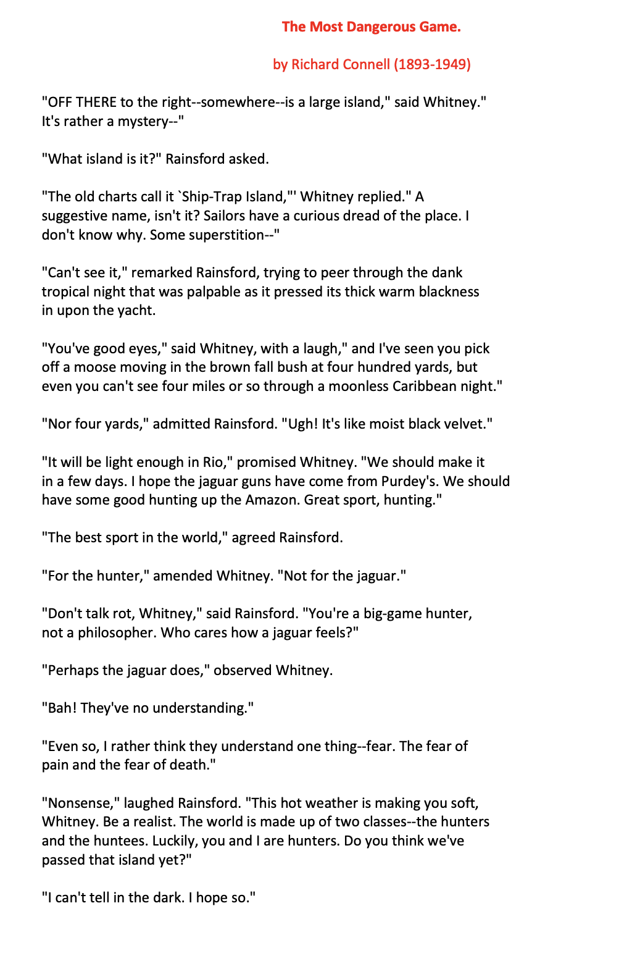
How Do Language Choices Affect Meaning & Tone?
Setting:
Middle of nowhere,
Nighttime
Dark, eerie
Devices:
Tone:
→ author builds a
Mysterious/ominous tone
(dark, curious dread→
Something is wrong
Foreshadowing?→hint about
What might come next.
Imagery→
Characterization
Rainsford & Whitney
Rainsford: logical, tough, even a bit arrogant
Whitney: empathetic.
Identify literary devices used (metaphor, diction, contrast, etc.)
Analyze how they shape the tone (cold? eerie? arrogant?)
Annotate to track our thinking — like a conversation with the text.

Slide 20
How to Annotate
What to Look For | What to Ask Yourself | What to Write
Tone words | What emotion do you feel here? | Circle tone words and label the tone
Figurative language | Why use this metaphor or simile here? | Underline and comment on effect
Contrast or irony | How does this shift our understanding? | Use ! or ? and write a note
Key dialogue | What does this reveal about the character's mindset? | Star it and explain their attitude
Imagery | What feeling does this sensory detail create? | Box it and describe the mood

Slide 21
What tone does the author establish in this dialogue? (page 1)
How does Rainsford’s word choice affect our view of him? (what words shape that tone?)
How do Whitney and Rainsford’s views on fear create tension in the story?
Do Rainsford’s words make you trust him more or less? Why?

Slide 22
Organizing Writing Effectively
When writing a response or analysis:
Clear structure helps the reader follow your argument.
Grouping ideas by topic (not chronology) builds stronger insights.
Starting broad → narrow lets you set context and go deeper.

Slide 23
Writing Prompt: How does Richard Connell use tone and characterization to introduce tension in The Most Dangerous Game? Drop any ideas you have

Slide 24
Step 1: Introduction
Start with a broad idea: conflict in literature
Narrow to The Most Dangerous Game
End with a claim (thesis):
Connell creates tension through ominous tone and Rainsford’s cold attitude, showing how danger can come from both nature and humans.

Slide 25
Step 2: Body Paragraphs – Group by Topic
Paragraph 1: Tone
Evidence: “thick warm blackness” / “moist black velvet”
Analysis: Builds an eerie, claustrophobic feeling.
Device: Imagery, metaphor
Link to theme: Nature as dangerous and unknown.
Paragraph 2: Characterization of Rainsford
Evidence: “Who cares how a jaguar feels?”
Analysis: Reveals his lack of empathy and foreshadows role reversal.
Device: Dialogue, contrast with Whitney
Link to tension: Makes the reader uneasy about his mindset.

Slide 26
Step 3: Conclusion
Restate your claim using fresh wording
Sum up your key insights (tone + characterization = tension)
End with a broader reflection — why does this matter?

Slide 27
Next class:
1. Short story analysis continued (The Most Dangerous Game by Richard Connell)
2. Writing strategies (quotations & analysis)
3. Grammar & Mechanics (sentences, fragments, and run-ons; phrases and clauses, subject-verb agreement, conjunctions)

Slide 28
Homework Assignment for today
Text: The Most Dangerous Game by Richard Connell Read the first 4 pages only (up to when Rainsford hears the gunshots and swims toward the sound). This section builds the setting and introduces the main character and early conflict.
Annotate as you read →

Slide 29
Annotation Instructions
Annotation Instructions
As you read, annotate at least two examples for each category below (6 total):
Tone
Circle any word or phrase that sets the mood.
In the margin, write the mood (e.g., mysterious, tense) and explain briefly why.
Characterization
Underline parts of the dialogue or narration that reveal something about Rainsford.
Write what the line tells us about his beliefs or personality.
Imagery or Figurative Language
Highlight/point out any descriptive language that appeals to the senses.
Write a quick comment: what image does it create? What effect does it have?

